Slide 1


Slide 2

Windows 10 Deployment - State of the Union
Johan Arwidmark, CTO, TrueSec @jarwidmark johan.arwidmark@truesec.com

Slide 3

Tweet, Tweet, Tweet

Slide 4

Windows 10 Challenges
WaaS – Processes / Testing
Reduce Network Impact
Readiness
Group Policies
BIOS / UEFI / TPM

Slide 5

DEMO

Slide 6
Deployment Scenarios
Bare Metal
Refresh
Replace
Inplace Upgrade (IPU)
Use the RIGHT Images!

Slide 7
DEMO

Slide 8



Resources: Trainings - Videos - Books
https://deploymentartist.com

Slide 9
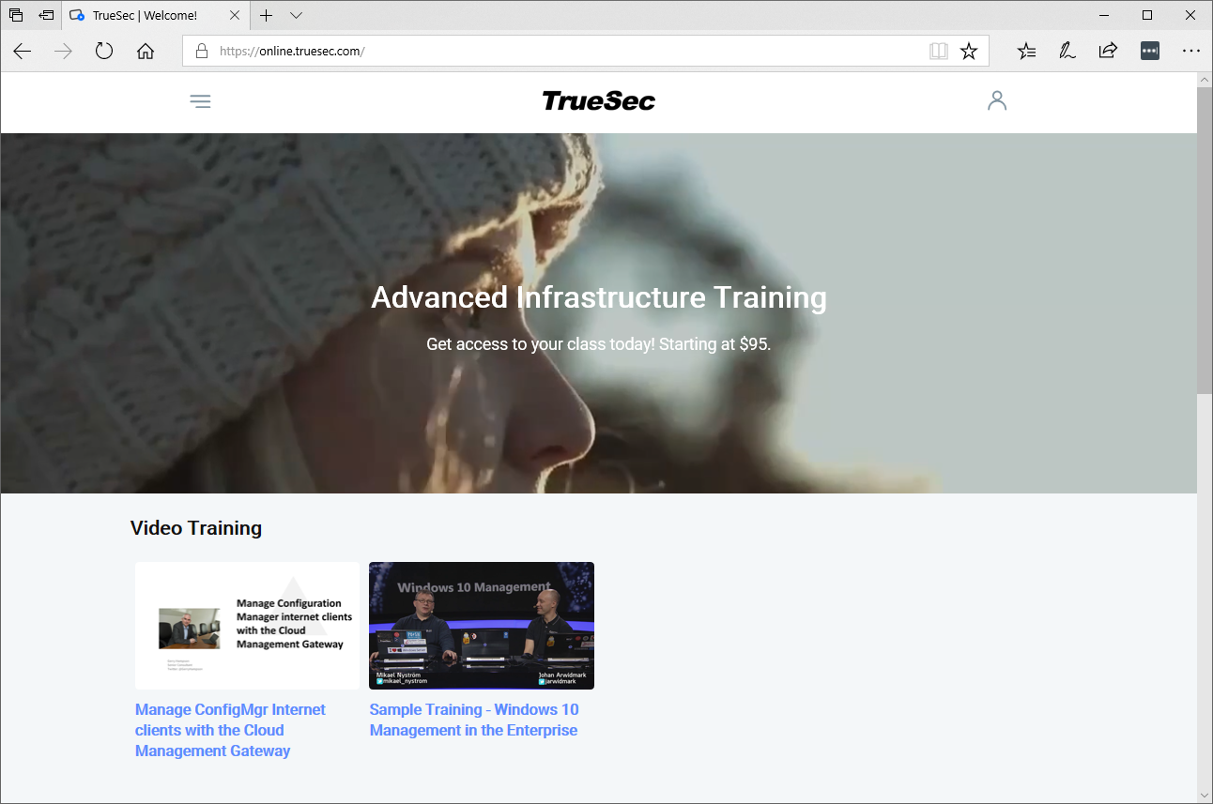
https://online.truesec.com

Slide 10

Slides and demos from the conference will be available at
https://github.com/nordicinfrastructureconference/2019

